Slide 1

Statistics for Data Analyst
FSA
Launch
For all your Analytical Needs!!!

Slide 2

If we google. We get many definitions of statistics
Statistics is in our head
I’m
Statistics
Collection
Analysis
DATA
Interpretation
But What exactly is statistics????
Organization
Presentation

Slide 3
Statistics is a crucial process behind how we make discoveries in science, make decisions based on data, and make predictions. The field of statistics is divided into two major divisions: descriptive and inferential. Each of these segments is important, offering different techniques that accomplish different objectives. Descriptive statistics describe what is going on in a population or data set. Inferential statistics, by contrast, allow scientists to take findings from a sample group and generalize them to a larger population. The two types of statistics have some important differences.
Statistics
Descriptive
Statistics
Inferential
Statistics
Presenting, Organizing &
Summarizing Data
Drawing conclussions based on data

Slide 4
Structure of Statistics
The study of statistics can be categorized into two main branches
Descriptive Statistics
Inferential Statistics
Descriptive Statistics is that branch of statistics which is concerned with describing the population under study
Organize, analyze and present data in a meaningful way
Final Result: Charts, Graphs and Tables
To describe a situation.
It explains the data, which is already known, to summarize sample.
Inferential Statistics is a type of statistics, that focuses on drawing conclusions about the population, on the basis of sample analysis and observation.
Compares, test and predicts data.
Final Result: Probability
To explain the chances of occurrence of an event.
It attempts to reach the conclusion to learn about the population, that extends beyond the data available.
VS.

Slide 5
Descriptive Statistics
Types of Descriptive Statistics
There are two kinds of descriptive statistics that data analyst use:
Measures of central tendency capture general trends within the data and are calculated
and expressed as the mean, median, and mode. A mean tells mathematical average
of all of a data set, the median represents the middle of the data distribution and, the
mode most common data repeated.
Central Tendency
Variability
Measures of Dispersion :The frequency distribution, which defines how many times a particular value occurs
within a data set. Measures of spread describe how the data are distributed and relate to each other,
including:
The range, the entire range of values present in a data set
Quartiles, subgroups formed within a data set when all values are divided into four equal parts across the range
Mean absolute deviation, the average of how much each value deviates from the mean
Variance, which illustrates how much of a spread exists in the data
Standard deviation, which illustrates the spread of data relative to the mean

Slide 6
Descriptive Statistics and Inferential Statistics
Descriptive statistics deals with the presentation and collection of data. This is usually the first part of a statistical analysis. It is usually not as simple as it sounds, and the statistician needs to be aware of designing experiments, choosing the right focus group and avoid biases that are so easy to creep into the experiment.
Inferential statistics, as the name suggests, involves drawing the right conclusions from the statistical analysis that has been performed using descriptive statistics. In the end, it is the inferences that make studies important and this aspect is dealt with in inferential statistics.
Descriptive statistics is the type of statistics that probably springs to most people’s minds when they hear the word “statistics.” In this branch of statistics, the goal is to describe. Numerical measures are used to tell about features of a set of data

Slide 7
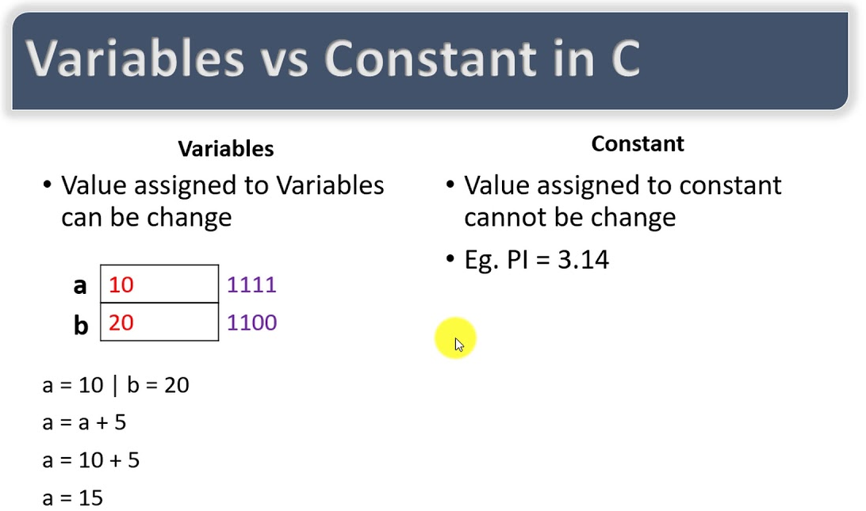
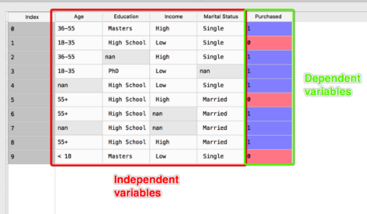
Basic terms
Variables are properties or characteristics of some event, object, or person that can take on different values or amounts. Constants do not vary.
Variables may be ... independent or dependent; discrete or continuous; qualitative or quantitative.

Slide 8
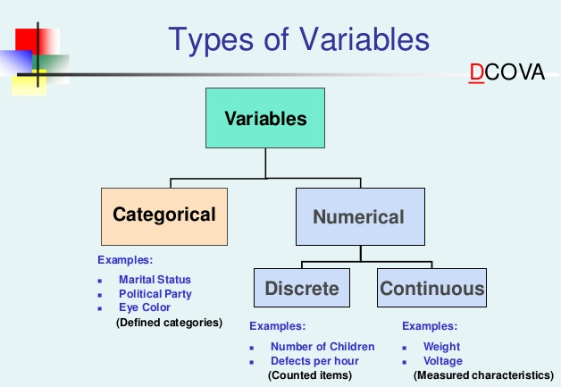

Slide 9
Dataset
Feature
Column
Variable
Discrete
variable
Continuous
variable
gender | race | education | lunch | test preparation course | math score | reading score | writing score
male | group B | master's degree | standard | none | 68 | 60 | 62
female | group B | associate's degree | standard | none | 59 | 69 | 70
male | group D | bachelor's degree | standard | none | 72 | 73 | 74
female | group C | associate's degree | standard | none | 66 | 85 | 75
female | group C | some college | standard | completed | 86 | 90 | 92
female | group C | some college | free/reduced | none | 73 | 92 | 91
Result
Pass
Fail
Pass
Fail
Pass
Pass
Edu
Math Score
Rows
Observation
Sample
Record
Datapoint
Lunch
Dependent
Feature
Note:
Complete Dataset is population
Only few records are samples.
Independent Feature

Slide 10


Population And Sample
Populations and samples Gathering all data is not always possible due to barriers such as time, accessibility, or cost. Instead of that, we often gather information from a smaller subset of the population, known as a sample.
Population: The entire set of possible observations in which we are interested Sample: A subset of the population from which information is actually collected
Inferential statistics is a collection of methods for using sample data to make conclusions about a population
Population
Types of Samples
Simple Random Sampling
Stratified Sampling
Cluster Sampling
Sample

Slide 11
Types of Data
The type of data collected depends on the question to be answered and the available resources.
There are two types of data: Qualitative and Quantitative.
Both types of data have strengths and limitations and may be appropriate for different settings, evaluation questions.
Quantitative data deals with numbers and things you can measure objectively: dimensions such as height, width, and length. Temperature and humidity. Prices. Area and volume.
Qualitative data deals with characteristics and descriptors that can't be easily measured, but can be observed subjectively—such as smells, tastes, textures, attractiveness, and color.
Qualitative data consist of words and narratives. The analysis of qualitative data can come in many forms including highlighting key words, extracting themes, and elaborating on concepts. Quantitative data are made of numerical information, the analysis of which involves statistical techniques. The type of data collected guides the analysis process.
An example of quantitative data would be a satisfaction survey asking participants to rate their experience on a scale of 1 to 5. In this case, the data would be numeric in form, and statistical techniques would be necessary to draw conclusions about participant satisfaction.

Slide 12
Quantitative Flavors: Continuous Data and Discrete Data
There are two types of quantitative data, which is also referred to as numeric data: continuous and discrete.
As a general rule, counts are discrete and measurements are continuous.
Discrete data is a count that can't be made more precise. Typically it involves integers.
For instance, the number of children (or adults, or pets) in your family is discrete data, because you are counting whole, indivisible entities: you can't have 2.5 kids, or 1.3 pets.
Continuous data, on the other hand, could be divided and reduced to finer and finer levels.
For example, you can measure the height of your kids at progressively more precise scales—meters, centimeters, millimeters, and beyond—so height is continuous data.

Slide 13

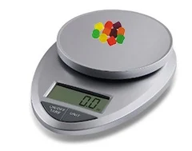
If we tally the number of individual pieces in a box, that number is a piece of DISCRETE data.
If we use a scale to measure the weight of each Pieces, or the weight of the entire box, that's COUNTNUOUS data.

Slide 14
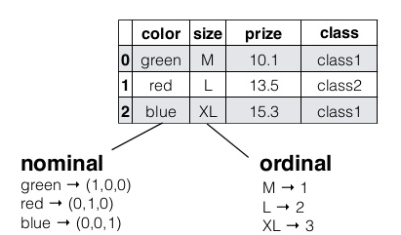

Qualitative Flavors: Binomial Data, Nominal Data, and Ordinal Data
Categorical Variables: The three types of categorical variables—binary, nominal, and ordinal
Binary: This type of variable lists two distinct, mutually exclusive choices. True-or-false and yes-or-no
Example: Yes or NO, True or False, Present or Absent, Sold or Not Sold.
Nominal: A categorical variable that has more than two categories to select from is called a nominal variable. Example: Grade A,B,C,D or Country, or Blood Group, or Type of food.
Ordinal: Another version of a categorical variable is an ordinal variable,
which has categories that can be put in a logical order.
Example Highest level of Degree.

Slide 15
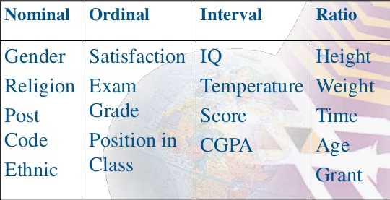
Continuous variables: The two types of continuous variables—Interval, Ratio
Interval Variables
The first type of continuous variable is the interval variable, a variable that can be ordered with a distance or level between each category that is equal and static.
Ex: What is the average daytime temperature in Fahrenheit during the summer in India ?
Ratio Variables
Another type of continuous variable is a ratio variable,
which has one difference from an interval variable:
The ratio between the scores provides information
about the relation between responses.
Ex: Kids weight. Or kids marks. If “0” weight means No kids.
Categorical
Continuous

Slide 16
Catergorical variable
Binomial
Pass or Fail
True or False
Nominal
Grade A,B,C..
Months
(Qualitative)
Or Discrete values
Oridinal
Scooling,
Degree,Masters
Continuous Variable
Interval
Temperature
Credit Score
(Quantitative)
Ranks, Rating
Ratio

Slide 17
Four fundamental scales:
Nominal: Names or categories
Examples include: gender, color, religion
Ordinal: Names or categories and order is meaningful
Examples include: Consumer satisfaction, Military rank, class ranking
Interval: Names or categories, the order is meaningful, and intervals have the same interpretation Example: Celsius temperature scale
Ratio: Highest and most informative scale
Contains the qualities of the nominal, ordinal, and interval scales with the addition of an absolute zero point Example: amount of money. zero money indicates the absence of money

Slide 18

Data analysis processes
Data Collection &
Preparation
Exploration
of Data
Analysis
Collect Data
Descriptive Statistics
Explore Relationship
Between
variables
Prepare Codebook
Set up Structure
of data
Graph
Compare
Groups
Enter Data
Screen Data for Errors
Descriptive Statistics

Slide 19
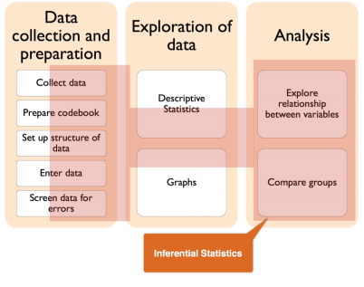
Data Analysis And Descriptive Statistics
Descriptive statistics are numbers that are used to summarize and describe data.
Descriptive statistics are just descriptive. They do not involve generalizing beyond the data at hand
Descriptive statistics is a collection of methods for summarizing data (e.g., mean, median, mode, range, variance, graphs).

Slide 20
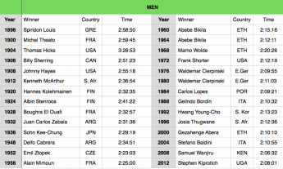

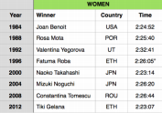
Descriptive statistics computed from the data
The average time
Women: 2:26:05
Men: 2:27:18
Women have been faster!

Slide 21
Charts and Graphs
$2Bn
20YY
20YY
Data A
Data B
Data C

Slide 22
Charts and Visualization
Data A
Data B
Data C

Slide 23
Charts and Graphs 2
30%
35%
35%
Data Cleaning.
Data Sorting
Analyzing data
Data A
Data B
Data C

Slide 24

Large image slide
Any Questions???
FUNKY TUNES

Slide 25

Thank You
FUNKY TUNES
Launch
Launch
BOFFIN
Mr Azhar
FSA

